Slide 1

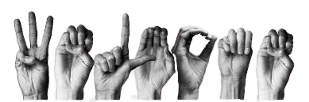
Indian Sign Language Detection
Jeya Santhosh Kumar D (19BCE0762)
CN Rohith Kumar (19BCE0781)
Vivek Reddy Y (19BCI0032)

Slide 2
Good Morning!

Slide 3
Abstract
Sign languages are systems of visual communication, used primarily by people from deaf communities around the world. In its most common form, words and phrases are signed by gesturing with fingers, hands, arms and facial expressions. Sign languages are fully developed languages with their own grammar and lexicon. Further, they differ from region to region and are often not mutually intelligible with each other, though some languages do possess similarities. They also differ from the spoken languages of a given area in terms of lexicon and rate of articulation. Indian Sign Language (ISL) is a complete language with its own grammar, syntax, vocabulary and other linguistic attributes. ISL varies considerably from its western counterparts in a variety of ways, most noticeably its lexicon, which displays a high level of iconicity. While most other sign languages have a few compound signs (signs consisting of two or more signs), in ISL the compounding system is pervasive. This project is to develop a concept of Indian sign language translator for people who are in need. This is achieved by using image processing and human hand gesture input. We collected Indian Lexicon Sign Language Dataset over numerous word signs from different word categories. We evaluate deep neural network combining different methods for augmentation, feature extraction, encoding and decoding.

Slide 4
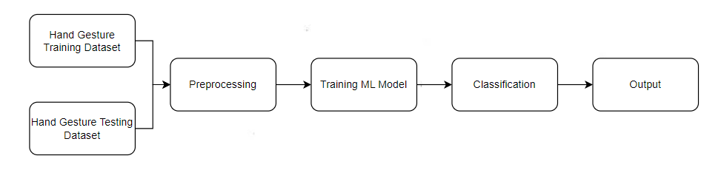
System Architecture

Slide 5
System Architecture
Here the hand gesture training dataset will take the input images and pre-processing is done. After pre-processing phase is done, the result is stored in the region of interest (ROI) model. In the ROI model the region that is required for classification is removed by applying the algorithms. The model is trained for different hand gestures and stores the data in the classification model. Later the testing is done for input images given by the user. Then the preprocessing is done for testing image using ROI, if the encoded input matches with the testing image, then classification is done with the training images. If the input matches with the training data, then respected output voice is played.

Slide 6
Methodology Adapted
Mediapipe Pose Detection is a computer vision technology that detects and tracks human body poses in real-time using machine learning algorithms. The methodology adapted for Mediapipe Pose Detection involves several steps:
Data Collection
Pre Processing
Model Architecture :LSTM Algorithm
Training
Inference

Slide 7
Software Requirements
Python Version 3.8
Python Packages
Keras
Tensorflow
MediaPipe
OpenCV
Tkinter
Numpy
Itertools
SKLearn

Slide 8
Hardware Requirements
2GB GPU
4GB RAM
Web Camera
Microphone
Processor Intel i3 or Above
Storage of 60GB
Cooling System

Slide 9
Expected Results and Discussion
The Label of the Predicted Gesture is to be Displayed for the appropriate Indian Sign Language. Atleast an Accuracy of 90% to be Achieved. The model should be Robust and Perform at much higher Speed.
The discussion of the results will focus on the strengths and limitations of the proposed system. The strengths of the system will include its high accuracy, real-time prediction capability, and user-friendliness. The system has the potential to significantly improve accessibility and communication for the deaf and hard of hearing community in India.

Slide 10
References
Chen, J.K. Sign Language Recognition with Unsupervised Feature Learning; CS229 Project Final Report; Stanford University: Stanford, CA, USA, 2011.
Sharma, M.; Pal, R.; Sahoo, A. Indian sign language recognition using neural networks and KNN classifiers. J. Eng. Appl. Sci. 2014, 9, 1255–1259.
Agarwal, S.R.; Agrawal, S.B.; Latif, A.M. Article: Sentence Formation in NLP Engine on the Basis of Indian Sign Language using Hand Gestures. Int. J. Comput. Appl. 2015, 116, 18–22.
Wazalwar, S.S.; Shrawankar, U. Interpretation of sign language into English using NLP techniques. J. Inf. Optim. Sci. 2017, 38, 895–910.
Shivashankara, S.; Srinath, S. American Sign Language Recognition System: An Optimal Approach. Int. J. Image Graph. Signal Process. 2018, 10, 18–30.
Camgoz, N.C.; Hadfield, S.; Koller, O.; Ney, H.; Bowden, R. Neural Sign Language Translation. In Proceedings of the IEEE Conference on Computer Vision and Pattern Recognition (CVPR) 2018, Salt Lake City, UT, USA, 18–22 June 2018; IEEE: Piscataway, NJ, USA, 2018.

Slide 11
Thank You

